Slide 1

IMDB Movie Analysis
Project By
Moksh Jaiswal

Slide 2
Contents
Project Description
Approach
Tech Stacks Used
Data Cleaning
Feedback
Problem Statement
Movie Genre Analysis
Movie Duration Analysis
Language Analysis
Director Analysis
Budget Analysis

Slide 3


Project Description
This project provides insights on Movies and the impact of the IMDB ratings in their success and their significance for movie producers, directors and investors using the given dataset.
The given dataset has 28 columns and 5044 rows.

Slide 4



Approach
The approach of this project is divided into three major steps
Data Cleaning
Data Analysis
Five Why’s Approach

Slide 5




.
Tech Stacks Used
Google Drive
Google Slides
MS Word 2019
MS Excel 2019

Slide 6
Data Cleaning
The Dataset given had 5044 rows (including headers)
and 28 columns before cleaning.
All the irrelevant columns were hidden and all the rows with
Blank cells were deleted.
After cleaning the dataset, there were 3738 number of rows
(including headers) .

Slide 7
.
Problem Statement
A. Movie Genre Analysis
B. Movie Duration Analysis
C. Language Analysis
Analyze the distribution of movie genres and their impact on the IMDB score.
Analyze the distribution of movie durations and its impact on the IMDB score.
Examine the distribution of movies based on their language.
D. Director Analysis
E. Budget Analysis
Influence of directors on movie ratings.
Explore the relationship between movie budgets and their financial success.

Slide 8
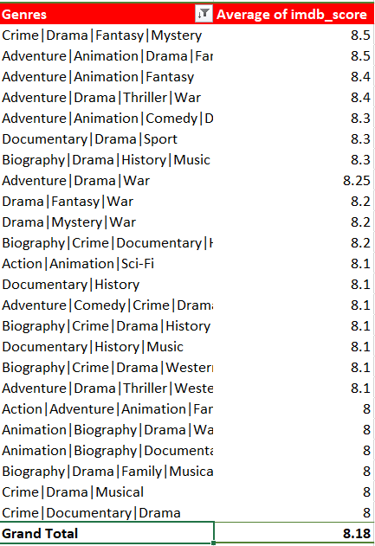
What are the top grouped genres as per ratings?
Created a pivot table and sorted the
Top 20 genres based on their IMDB ratings.
Created a chart for better understanding of the same through
Visualization.

Slide 9
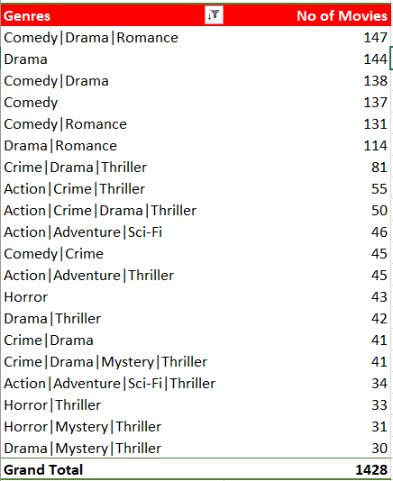
What are the top grouped genres as per movies?
Created a pivot table and sorted the
Top 20 genres based on their count
(number of Movies with a specific genre ).
Created a chart for better understanding through
Visualization.

Slide 10
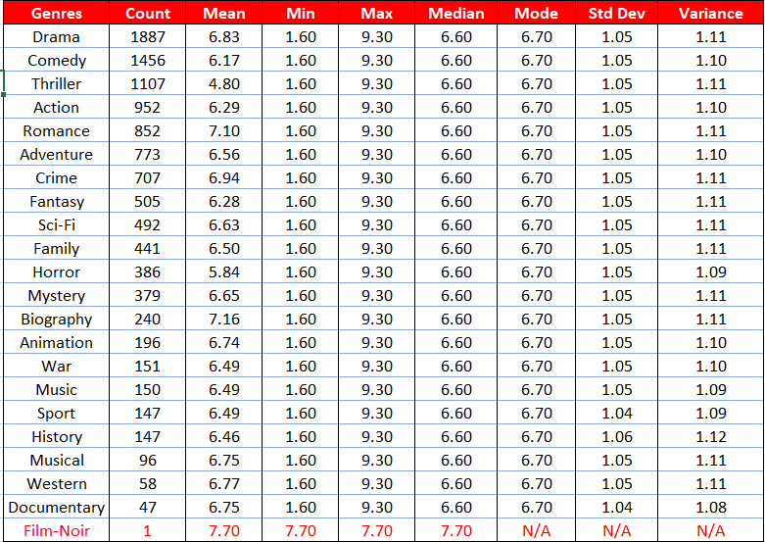
What are the top genres individually?
For executing the following analysis the grouped genre column was split into different columns for each genre of a movie. Thereafter, Excel
Functions like COUNTIF, AVERAGEIF, IF, MIN, MAX, MEDIAN, STDEV.S and VAR.S were used to obtain their respective descriptive statistics.
Here, as the genre Film – Noir appears only once, it is an outlier.
It is evident from the table that, each genre has a consistent central
tendency (Median), a distinct peak (Mode), and a similar spread
(Range) across genres as these values does not get affected by
Extreme values.
However, the fact that Mode (very slightly) > Median still reflects a
slight imbalance in the distribution or presence of a few values that are
more frequent. This could be related to certain attributes that are
common within each genre like the sub – genre .
The fact that the Means differ might be due to varying levels of
skewness caused by outliers or extreme values in each genre.

Slide 11

Here, we can observe that the most common genre
Individually is Drama, occurring in 1887 films and the
Least appearing genre is Film – Noir, appearing only once
Which is an interesting outlier.
There is not much difference amongst all the genres in
terms of their IMDB rating. However, the least rated genre
Is Thriller even though it contributes in 1107 movies.
Although Film – Noir has the most rating of 7.7 it is
considered as an outlier as it only appears once .
So, The Genre with the most rating is Biography with 7.2,
Followed by Romance with 7.1 rating.
Outlier

Slide 12
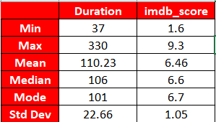
Are Movie Duration and Their ratings correlated?
First, the relevant columns were extracted and Excel Functions like MIN, MAX, AVERAGE, MEDIAN, MODE, STDEV.S and CORREL were used
To obtain the desired results.
In summary, the data on movie durations seems to be relatively normally distributed with a mean close to the median, indicating a roughly
symmetrical distribution. The mode being lower than the mean and median might suggest that while 101 minutes is a common duration, there
are also longer movies that are affecting the mean. The standard deviation indicates that there's a moderate spread of durations around the
mean, with some movies deviating more from the average length than others. This dataset could reflect a diverse range of movie lengths,
with a notable concentration around 101 minutes.
Whereas, in IMDB scores, the Mean < Median < Mode which indicates that the distribution is negatively skewed where the majority of data points
are on the lower end of the scale. This distribution suggests that there are more movies with ratings on the higher end of the scale, with a few lower-rated movies pulling down the mean and impacting the median to a lesser extent.

Slide 13
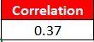
The relation here is linear and as the points are scattered near that line, by looking at the spread we can say that the
relation is moderate which, with the help of Excel function we got as 0.37 which states the same.

Slide 14
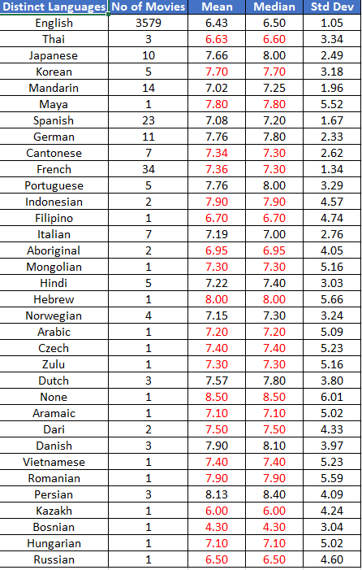
What are the most common Languages?
The language English here is an outlier with extreme numbers of movies in comparison
to the others.
Then, the language French comprises of most number of movies followed by Spanish,
Mandarin, German and Japanese as the only languages with movies more than 10.
All the other languages have movies less than 10.
Other than this, most the languages have equal Mean and Median and those that differ,
they differ from a very small margin with Mean < Median. This Indicates that the bulk of
Data is concentrated towards movies with less numbers. i.e. skewed towards higher
Values.

Slide 15
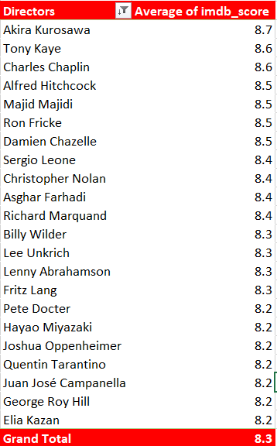
Which Directors are the top rated ones?
Created a pivot table and sorted the
Top 20 genres based on their average
IMDB ratings.
Created a chart for better understanding of the same through
Visualization.

Slide 16
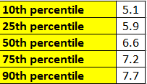
What is the percentile distribution of directors as per their ratings?
Firstly, the required columns were extracted from the given dataset and then to calculate mean scores of directors,
percentile of mean scores, and for comparing the results, Excel functions like AVERAGEIF, PERCENTILE.INC, and IF
is used.
Then conditional formatting is done in the result table for better understanding.
The given below are the Percentiles of mean scores of ratings of various directors.

Slide 17
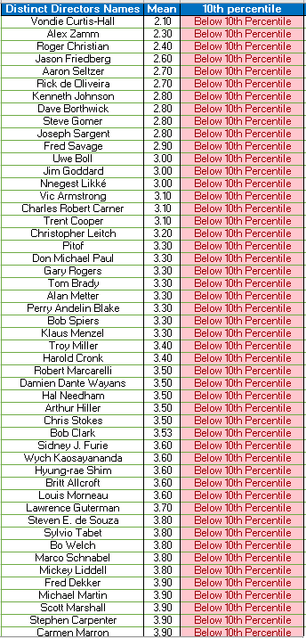
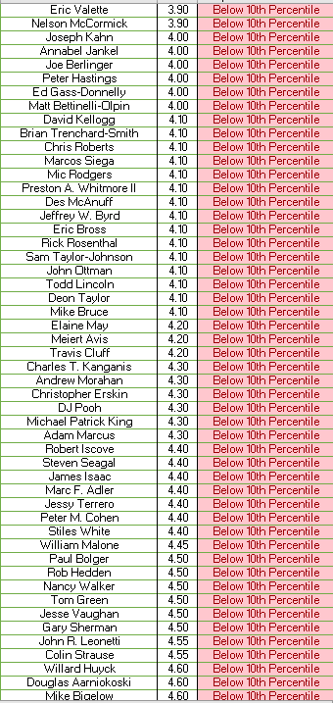
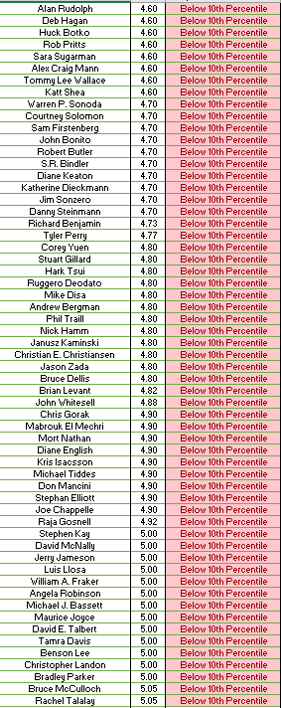
Least Rated Directors
These are all the Directors with Mean Scores below 10th Percentile (< 5.1). This means that 10% of the data falls below 5.1

Slide 18
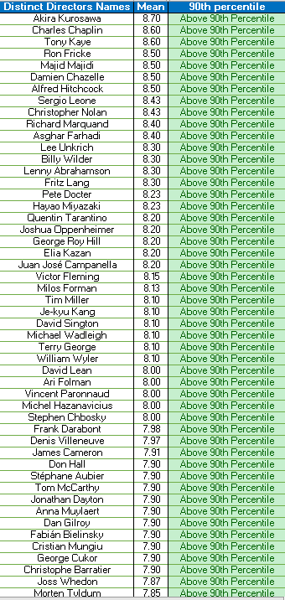
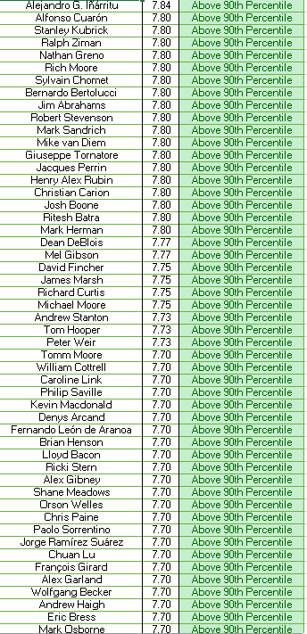
Top Rated Directors
These are all the Directors with Mean Scores above 90th Percentile ( >7.7 ). This means that 90% of the data falls below 7.7

Slide 19
Are Budget and Gross Correlated?
To Calculate the correlation between Budget and Gross, Excel function CORREL is used.
Here the calculated correlation is very near to 0 and thus, it suggests extremely low positive linear relation i.e.
No linear relation at all between the two variables.
This can also be seen via scatter plot where all the points are scattered far away from the trendline.

Slide 20
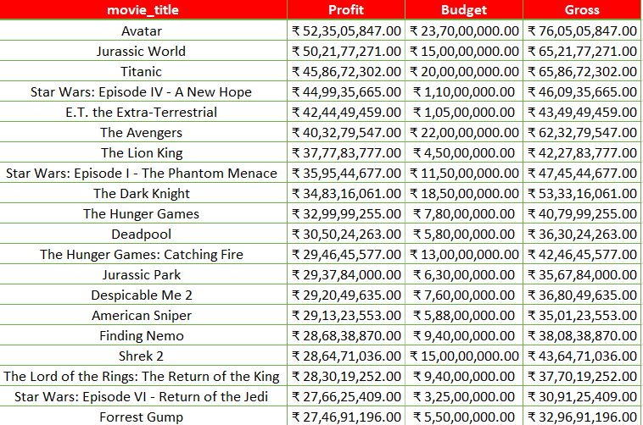
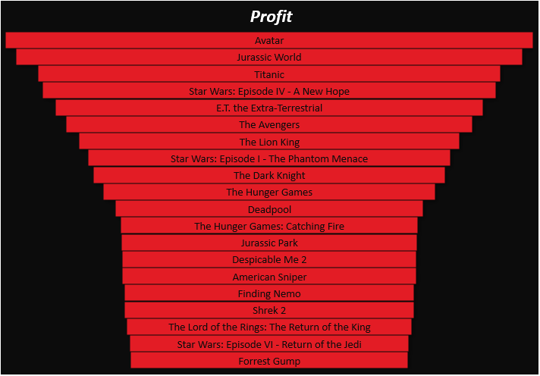
Which Movies have the most Profit?
To calculate the profit we have added a new calculated column by subtracting Gross from Budget.

Slide 21
.
Drive Link For The Project -
Presentation :
https://docs.google.com/presentation/d/1eITBy-KzD70wpgvJxY_RHZ4MGlah8GeW/edit?usp=sharing&ouid=105366244794451882696&rtpof=true&sd=true
Excel File :
https://docs.google.com/spreadsheets/d/1_qC2Rv1fLmu0fMIENZeXGE2OnfRJi-zp/edit?usp=sharing&ouid=105366244794451882696&rtpof=true&sd=true
E-mail here for Feedback -
moksh.jaiswal2004@gmail.com

Slide 22


THANK YOU

